Slide 1
Unnecessary and “trash” comments on YouTube Shorts
Jonas Kirkilovskis, Adomas Pimpė, Aringas Civilka

Slide 2
Contents
Introduction
Literature Review
Hypotheses / Research Questions
Methodology
Raw Data
Examples
Data Analysis
Discussion – SWOT / Benefit to The World
Conclusion
References

Slide 3
Introduction

Slide 4
Literature review
Oana Ignat, Xiaomeng Xu, Rada Mihalcea “MAiDE-up: Multilingual Deception Detection of GPT-generated Hotel Reviews
Seung Ho Na, Sumin Cho, Seungwon Shin “Evolving Bots: The New Generation of Comments Bots and their Underlying Scam Campaigns in YouTube”
A. Marthe Möller, Susan A. M. Vermeer, Susanne E. Baumgartner “Cutting Through the Comment Chaos: A supervised Machine Learning Approach to Identifying Relevant Youtube Comments”

Slide 5

Research questions
How common are irrelevant or “trash” comments on YouTube Shorts?
What categories of low-value comments are most common on YouTube Shorts?

Slide 6
Hyphotheses
Approximately 50% of YouTube Shorts comments are unnecessary and provide little to no informational or conversational value.
The most popular sub-category of unnecessary comments will be short comments.

Slide 7
Research methodology

Slide 8


Research methodology
100
Videos
3xLo3rkRsbI
ZIxrkpBnPGY
En4vNg51NEY
-xic5bJIuQM
WUPdiXuX1pw
...

Slide 9

Research methodology
1000
Comments per video
Sentence transformers 5.1.2
Total: 65964 comments

Slide 10
Research methodology
Flag | Criteria
Many Emojis | 🔥 > 40% of comment is emoji 🔥
Short | Comment length < 6
Repetitive | Repeating characters(3) or words(3), e.g.: "abcabcabcaserj" "lolololwwww" ...
Glazy | The comment is clearly bot spam, e.g.: "I'll definitely rewatch this later." "Your explanation is well made I did not expect it to be this good." ...

Slide 11

Research methodology
Sentence transformers 5.1.2

Slide 12
Raw Data

Slide 13
Raw Data

Slide 14
Raw Data

Slide 15
Raw Data

Slide 16
Raw Data

Slide 17
Raw Data

Slide 18
Examples

Slide 19
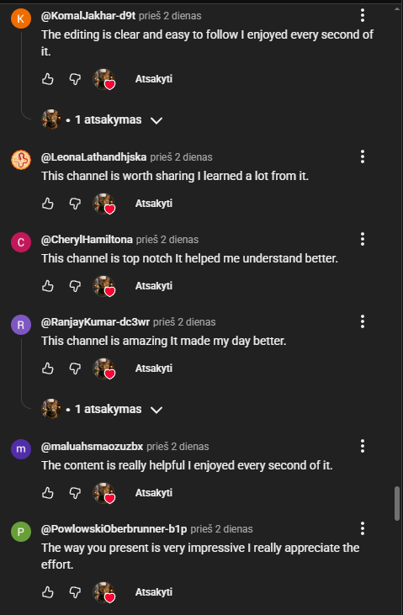
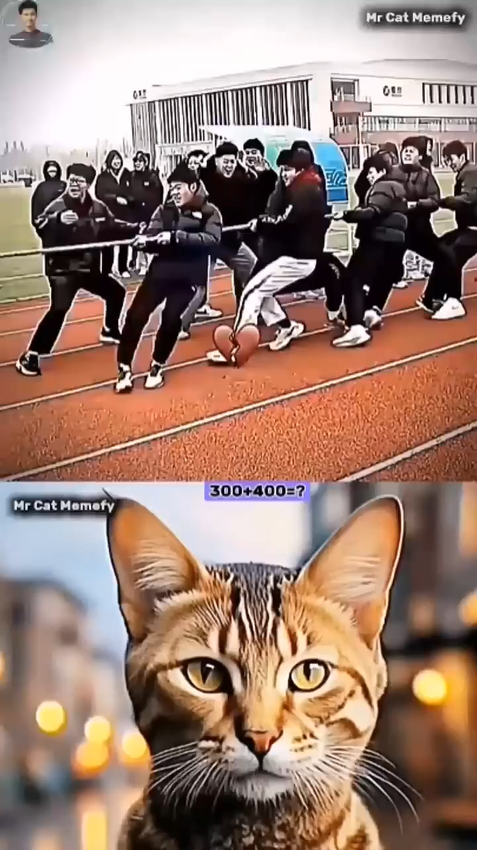
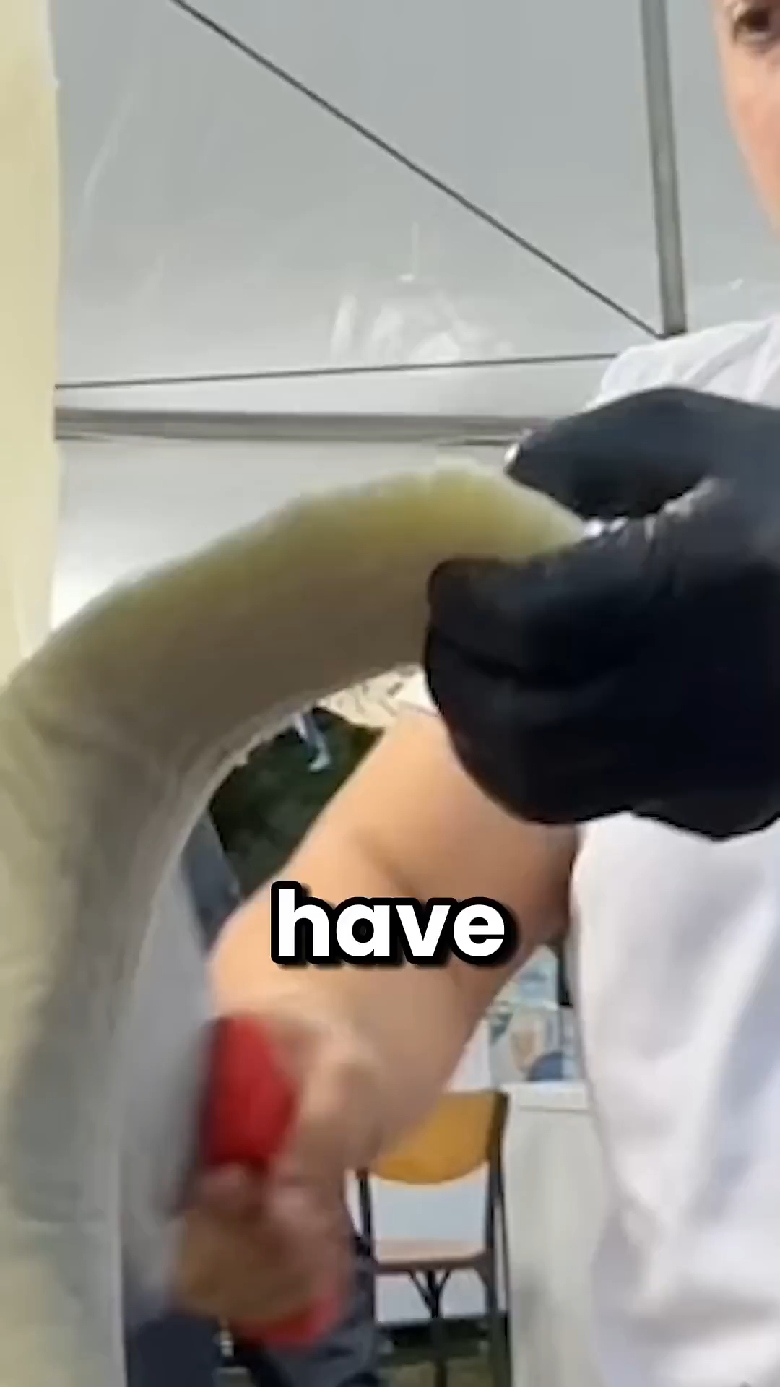
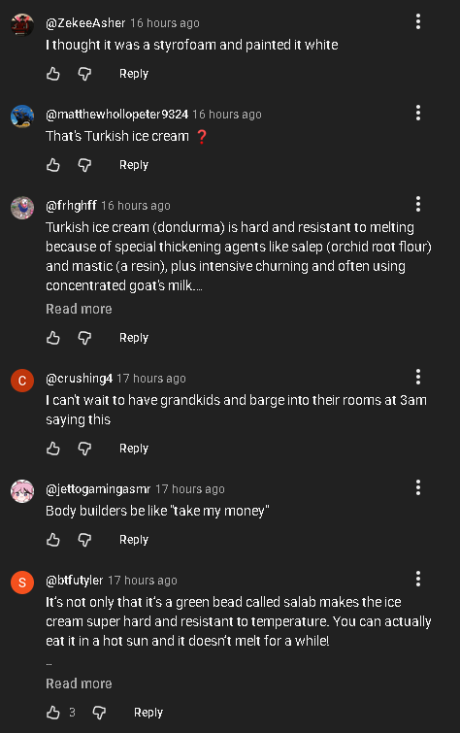
Examples
Highest percentage of “trash” comments
Lowest percentage of “trash” comments
https://www.youtube.com/shorts/HjSZT1V2wpc
https://www.youtube.com/shorts/a1ifEyPmRgM

Slide 20
Data Analysis

Slide 21
Data Analysis
37% of all comments were “trash”.
20% of all videos had more “trash” than normal comments.
Non-flagged comments received 70% more engagement than flagged ones.
Most popular category was short comments.

Slide 22
Discussion

Slide 23

SWOT
Relevant and modern topic
Data-driven approach

Slide 24

SWOT
Limited dataset size
Subjectivity in “value” judgment
Basic algorithm

Slide 25

SWOT
Potential for future research
Could inspire better moderation tools
Easy to expand dataset

Slide 26

SWOT
Changes in YouTube’s moderation
Bots becoming more advanced
Comments are ever-changing

Slide 27
Benefit to the world
Improving online conversation quality
Reducing misinformation
Helping platforms detect spam more effectively
Raise awareness of the current situation

Slide 28


Conclusion
Approximately 50% of YouTube Shorts comments are unnecessary and provide little to no informational or conversational value.
The most popular sub-category of unnecessary comments will be short comments.

Slide 29
References
Oana Ignat, Xiaomeng Xu, Rada Mihalcea. (2024). MAiDE-up: Multilingual Deception Detection of GPT-generated Hotel Reviews.
Seung Ho Na, Sumin Cho, Seungwon Shin. (2023). Evolving Bots: The New Generation of Comments Bots and their Underlying Scan Campaigns in Youtube.
A. Marthe Möller, Susan A. M. Vermeer, Susanne E. Baumgartner. (2024). Cutting Through the Comment Chaos: A supervised Machine Learning Approach to Identifying Relevant Youtube Comments.
Youtube Data API v3 (developers.google.com)
all-MiniLM-L6-v2-sentence-transformer (huggingface.co)
Logos: Excel, Incognito, Python, YouTube‘s Shorts
Example videos: Video 1, Video 2 (youtube.com)

